Slide 1
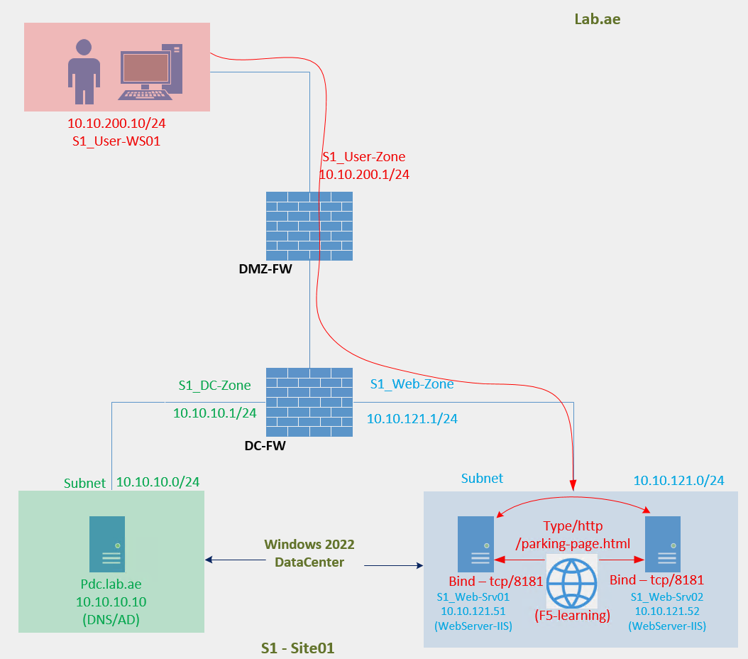

F5 LTM Learning with
Alexander S

Slide 2
F5 LTM Learning Series
Chapter 02 – Verify that the Web Application is accessible from the Client Machine to WebSrv01 and WebSrv02

Slide 3
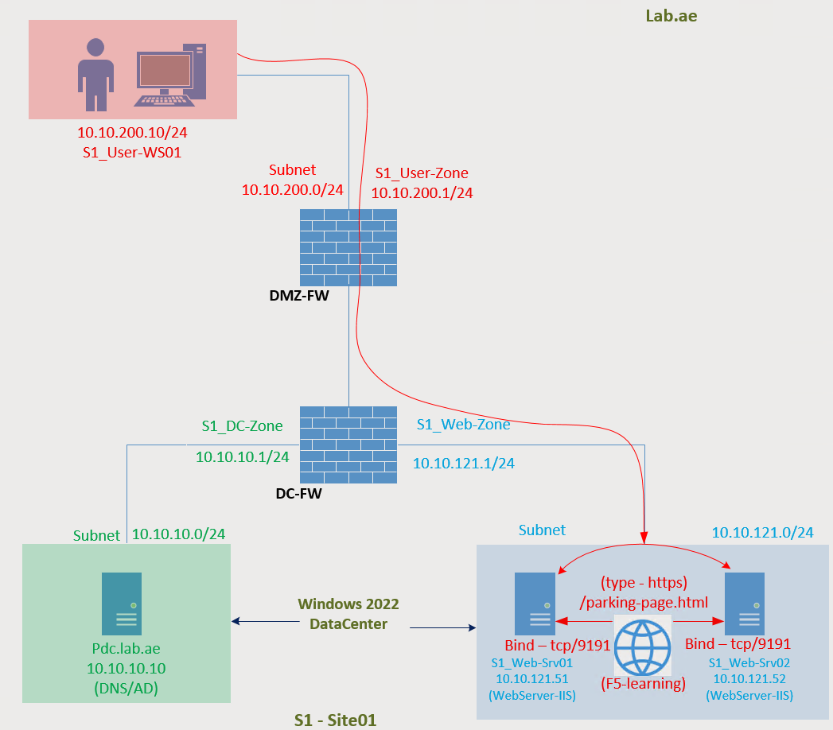
    Chapter 02 - Verify that the Web Application is accessible from the Client Machine
    Lab Topology – User traffic flow to access the web application on SRV01 and SRV02
User-Zone
Subnet : 10.10.200.0/24
Gateway : 10.10.200.1
User-WS01 : 10.10.200.10

Slide 4
Chapter02 is continuation of Chapter01
You must complete Chapter 01 first before proceeding with this chapter!

Slide 5
    Chapter 02 - Verify that the Web Application is accessible from the Client Machine
    Lab Topology – User traffic flow to access the web application on SRV01 and SRV02
User-Zone
Subnet : 10.10.200.0/24
Gateway : 10.10.200.1
User-WS01 : 10.10.200.10

Slide 6
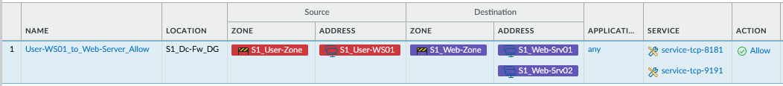
    Chapter 02 - Verify that the Web Application is accessible from the Client Machine
    Lab Topology – The required security policies have been configured to allow users to access Web-SRV01 and Web-SRV02.

Slide 7
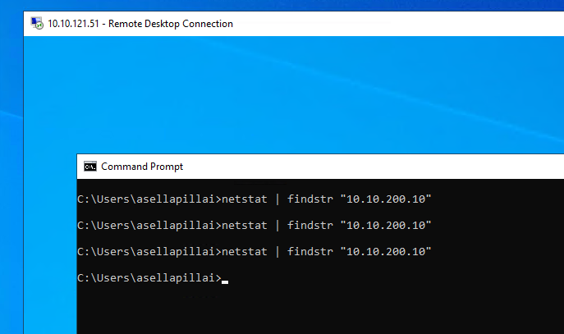
    Chapter 02 - Verify that the Web Application is accessible from the Client Machine
    Users to access Web-SRV01 and Web-SRV02 troubleshooting – Let us check the firewall logs
Traffic Allowed: The logs confirm that the connection is permitted.
Bytes Sent: This indicates that the request was successfully sent from the client.
No Bytes Received: This means there was no response returned and connection aged out.

Slide 8
    Chapter 02 - Verify that the Web Application is accessible from the Client Machine
    Users to access Web-SRV01 and Web-SRV02 troubleshooting – Let us check the website on the server itself
For the http application, try
netstat -an | findstr ":8181"
Great! The port is listening.
For the https application, try
netstat -an | findstr ":9191"
Great! The port is listening.
Alright, since the port is listening, let’s go ahead and test the web application locally on the server.
Perfect - it works!
That means we’ve confirmed the application is up and running!
Verify User Traffic Reaching the Server
Let’s use the netstat command to check whether user traffic is reaching the server.
netstat -an | findstr "10.10.200.10"
If the output is empty, it indicates that no traffic from the user machine is reaching the server.
In other words, the server is not seeing any incoming connections from the client IP.

Slide 9
    Chapter 02 - Verify that the Web Application is accessible from the Client Machine
    Users to access Web-SRV01 and Web-SRV02 troubleshooting – How to troubleshoot this?
The application is working when tested locally on the server.
The network firewall has been verified, and traffic is allowed.
Using the netstat -an command on the server shows that not traffic is reaching the server from the client.
In summary, even though the network firewall allows the traffic, it is not reaching to the web server!!!

Slide 10
    Chapter 02 - Verify that the Web Application is accessible from the Client Machine
    Users to access Web-SRV01 and Web-SRV02 troubleshooting – Use packet capture tool like Wireshark
In this case, the traffic is most likely being blocked by endpoint security on the server.
Also, netstat won’t help in troubleshooting because,
netstat → shows only active sockets known to the OS. If endpoint security blocks a connection before the socket is established, it won’t appear.
Wireshark → captures raw packets at the NIC/driver level. Even if the OS rejects or blocks them, the packets may still be visible.
To confirm whether the traffic is reaching the server but being blocked by end point security - we need to capture the network packets.
A troubleshooting tool like Wireshark can help us to capture the packets.

Slide 11
    Chapter 02 - Verify that the Web Application is accessible from the Client Machine
    Users to access Web-SRV01 and Web-SRV02 troubleshooting – Create a Security Rule in Windows Firewall
Our End Point Security is Windows Defender Firewall
Let us create the security policy in windows defender firewall to allow it

Slide 12

    Chapter 02 - Verify that the Web Application is accessible from the Client Machine
    Users to access Web-SRV01 troubleshooting – Windows Firewall was blocking
Web-Srv01 windows firewall was blocking the connection.
We have created security policy to allow it.
Now it is working fine.

Slide 13
We successfully tested the Learning Portal website from the user machine (User-WS1) to both Web-Server01 and Web-Server02, and it is working perfectly! ✅
This concludes Chapter 02!
Please continue watching Chapter 03 - where we will discuss the need for a Reverse Proxy, focusing on load balancing and security.
Thank you for watching!
    Chapter 02 - Verify that the Web Application is accessible from the Client Machine

